Slide 1
Company Overview
Pharma Source Global is an emerging pharmaceutical sourcing and formulation company, headquartered in Brisbane, Australia, with operational presence in India.
We specialize in bridging high-quality pharmaceutical raw materials from compliant Indian manufacturers to formulators in Australia and New Zealand.

Slide 2
Founders & Leadership
Founded by Dr. Madhu Lakshmaiah, and driven by his strategic vision, the company is operationally led by:
Mr. Mohan, Chief Operating Officer, based in Hyderabad, India
Mr. Manoj Kumar, Technology Director, based in Brisbane, Australia.
We combine agility with a strong focus on regulatory compliance and possess deep market insights into both Australia and India. We serve clients in the highly regulated and precision-driven pharmaceutical sector.

Slide 3
Vision Statement
Our Vision: To build long-term sourcing partnerships, delivering high-quality pharmaceutical raw materials to Australia and New Zealand, while ensuring compliance, transparency, and growth. Providing Market Access, Formulations, Technical Support, and Mutually Beneficial Partnerships to aspiring Indian companies.

Slide 4
Regulatory & Quality Framework
Supplier engagement based on GMP/ISO and country-specific regulatory compliance
Compliance with Drugs & Cosmetics Act, GMP, and USP global best practices
End-to-end Regulatory Compliance and Logistics Management
Coordinated documentation, licensing, and Assurance & Regulatory Compliance

Slide 5
Operational Model
Lean & Agile Model:
Avoids excess warehousing or fixed asset burden
Focuses only on what is needed
Key Practices:
Efficient balance between Just In Time (JIT) and Just Too Late (JTL) models
Ensures supply On Time In Full (OTIF)
Aims to minimize inventories through tight coordination and demand matching

Slide 6
Regulatory Commitments
Document Transparency: COAs, MSDS, and Regulatory Documents shared upfront
WHO-GMP / ISO / OHSAS Certified manufacturing partners
Willingness to serve international markets, adhering to regulatory requirements
Swift response to trial orders where required
Manufacturers must be able to supply to our Indian subsidiary or Australian company
Emphasis on clear documentation and transparent communication — poor communication is not acceptable in our partnerships

Slide 7
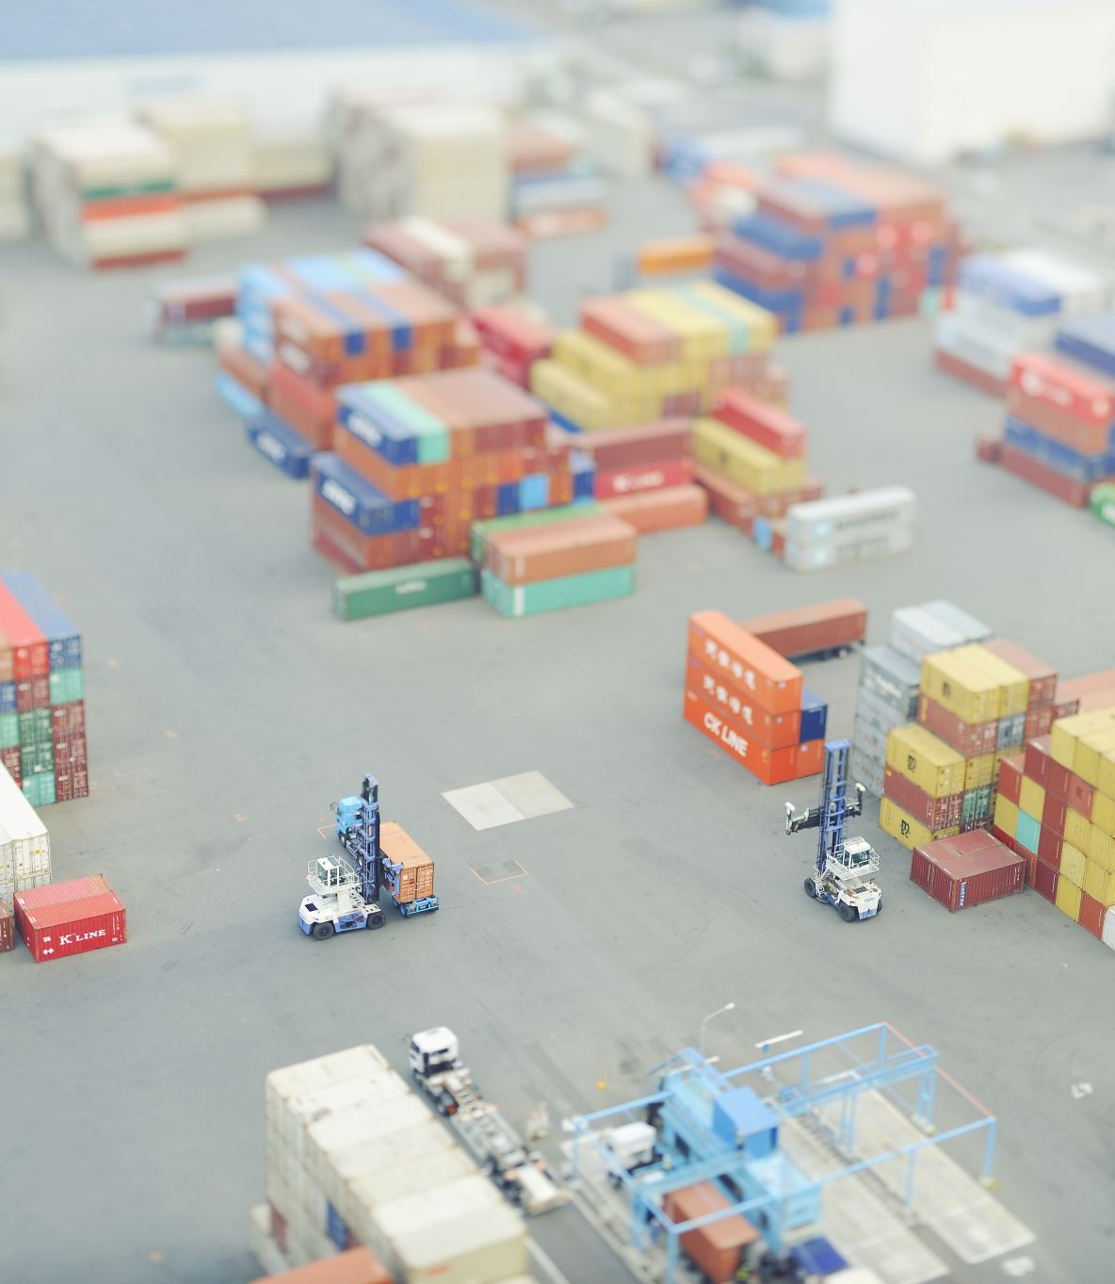
Strategic Expansion Plan
Operational Presence:
Commencing with Australia, New Zealand, and India
Expansion across APAC, Europe, Americas, Middle East & Africa
Delivery Terms:
Flexible delivery options such as CIF–Brisbane and Ex-Works
Logistics Advantage:
Lean, digitally coordinated logistics with strong supplier collaboration

